Slide 1
Topic: Bivariate Data EQ: What is Correlation?

Slide 2
24
7
30
Date
Bivariate Data
EQ: What is correlation?
What is Correlation?
5

Slide 3
24
7
30
Date
Bivariate Data
EQ: What is correlation?
What is Correlation?
A correlation indicates a relationship between two variables
What are the types of relationships?
5

Slide 4
24
7
30
Date
Bivariate Data
EQ: What is correlation?
What is Correlation?
A correlation indicates a relationship between two variables
What are the types of relationships?
5

Slide 5
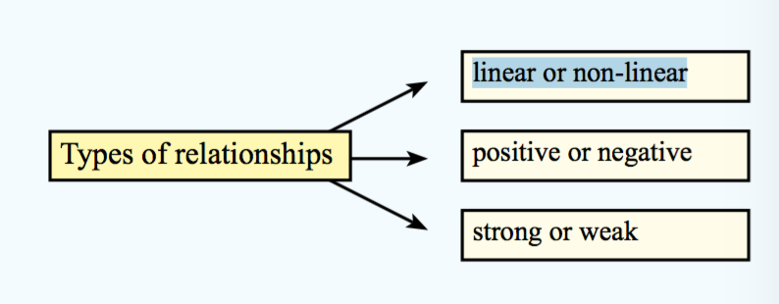
24
7
30
Date
Bivariate Data
EQ: What is correlation?
What is Correlation?
A correlation indicates a relationship between two variables
What are the types of relationships?
5

Slide 6
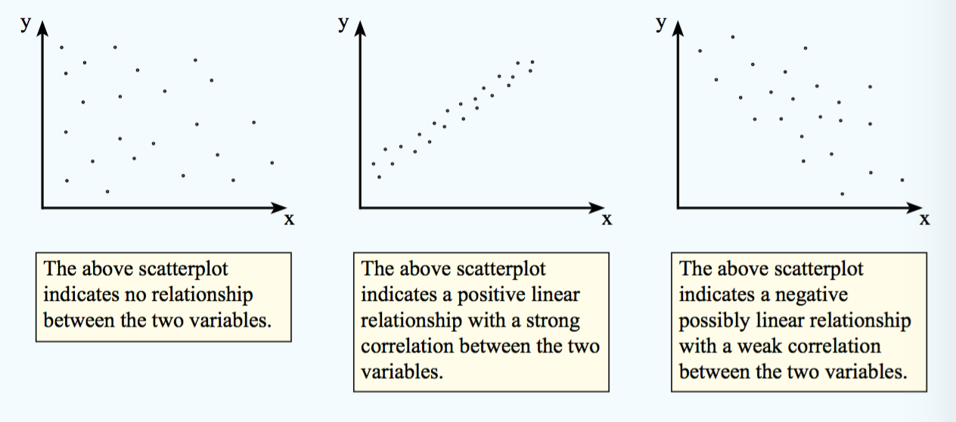
24
7
30
Date
Bivariate Data
EQ: What is correlation?
5

Slide 7
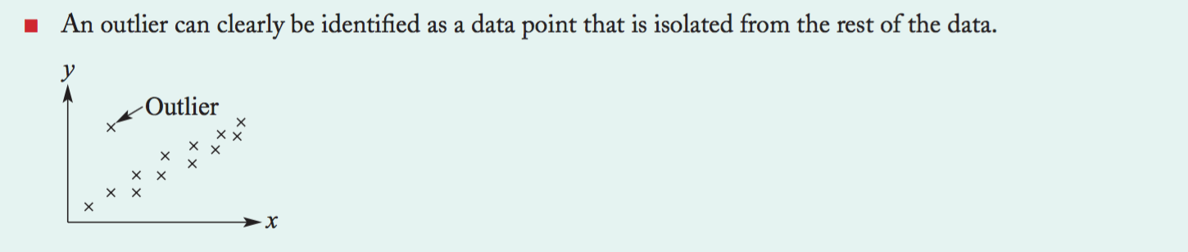
24
7
30
Date
Bivariate Data
EQ: What is correlation?
5

Slide 8
Notes Review
24, 7 ,30
Date
Title
Essential question
Notes complete
Notes complete with colour and diagrams
Questions completed
Contents page filed in
Formula page filled in

Slide 9
Homework
Review your notes and write a summary answering the essential question.

